Slide 1
Creating New Projects in Basecamp

Slide 2
There are several ways to manage new projects in Basecamp
New Project Tiles by Project
New Projects share a Tile – Divided by Project Headings
New Projects share a Tile – Divided by Project Stage

Slide 3
1 - New Project Tiles by Project
Pro’s
  Clearly defining each project separately
  Work can focus on one project at a time
  Basecamp To-Do’s under each heading can be assigned to a party and dated which will appear on the Calendar
Con’s
  Work that is done on one project that is also applicable on another would need to be copy/pasted onto a completely separate project tile

Slide 4
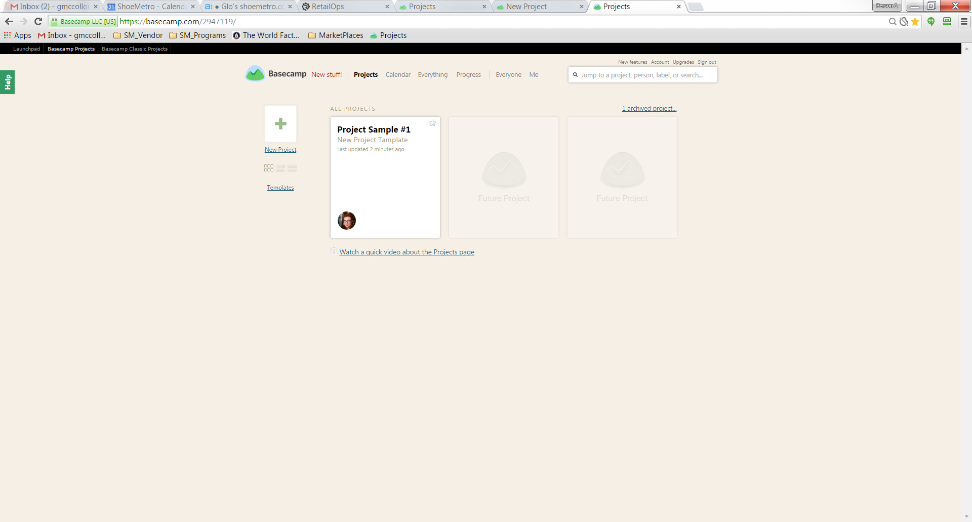

New Project Tiles by Project
Create a new project tile
That new project should have pre-defined template To-Do’s
  Example Headers
    Scope
    Estimate
    Design
    Development
    Test & QA
    Launch

Slide 5
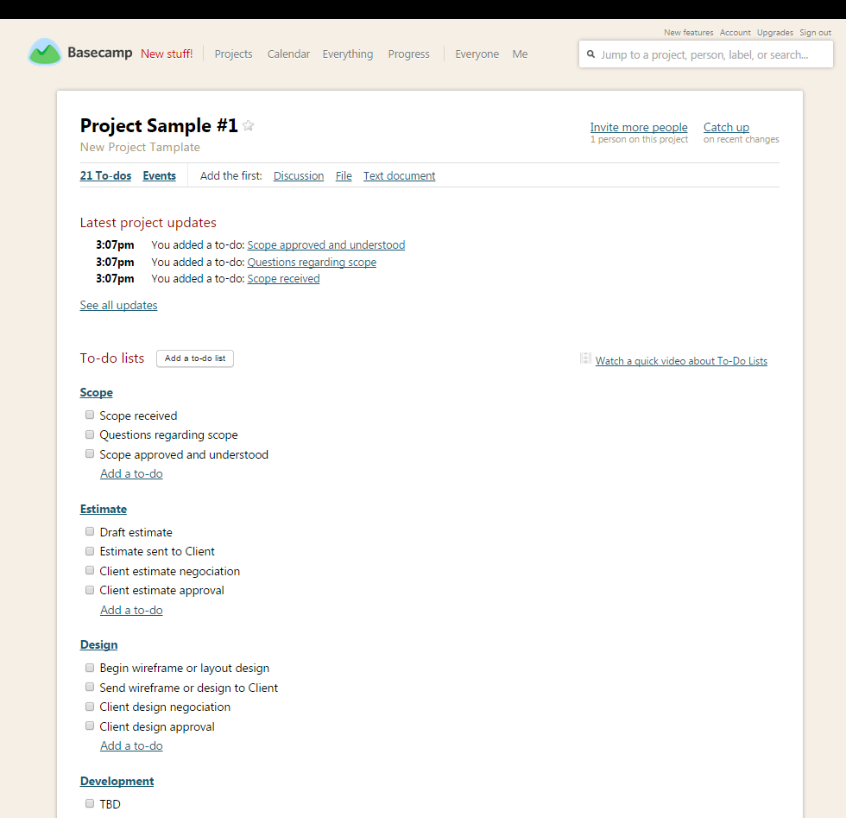
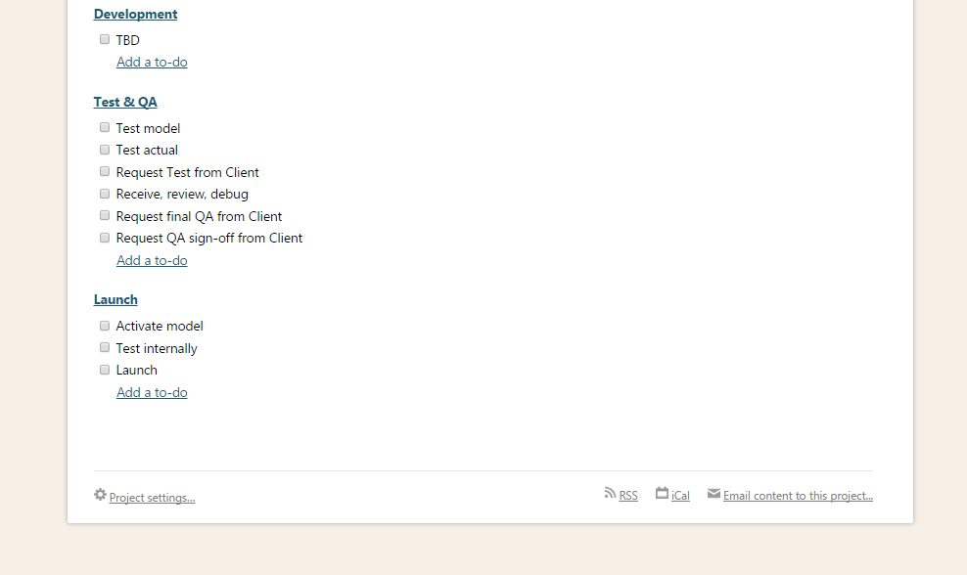
1 - Template
Example

Slide 6
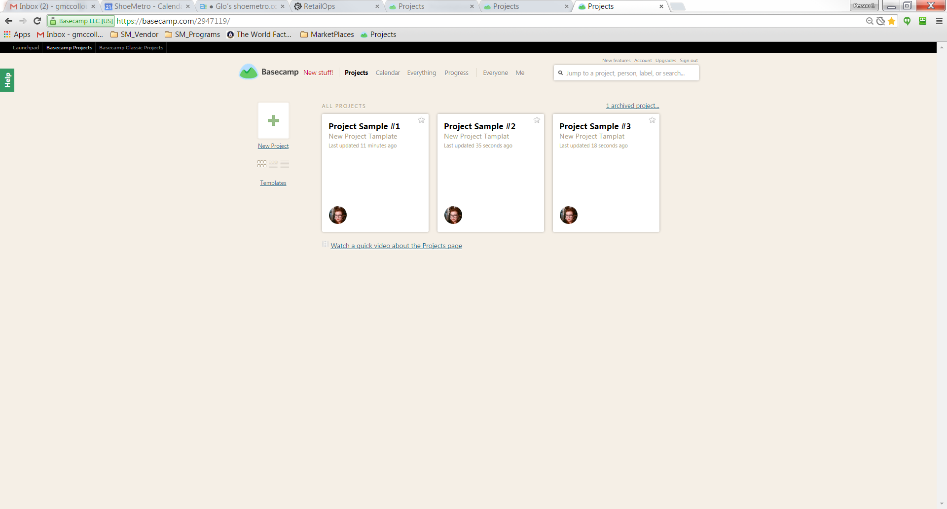
New Project Tiles by Project

Slide 7
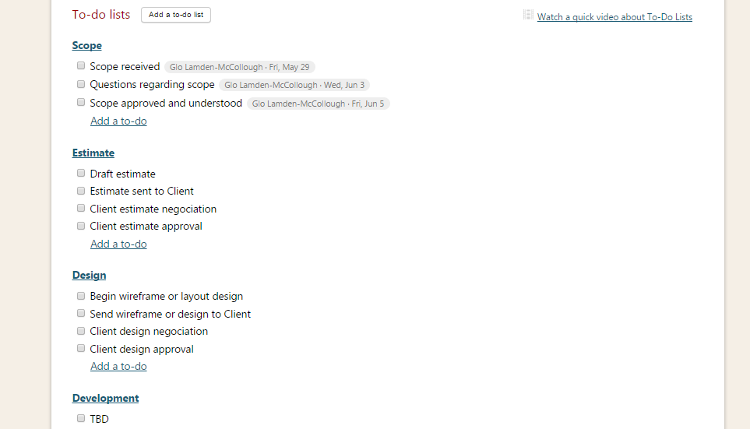
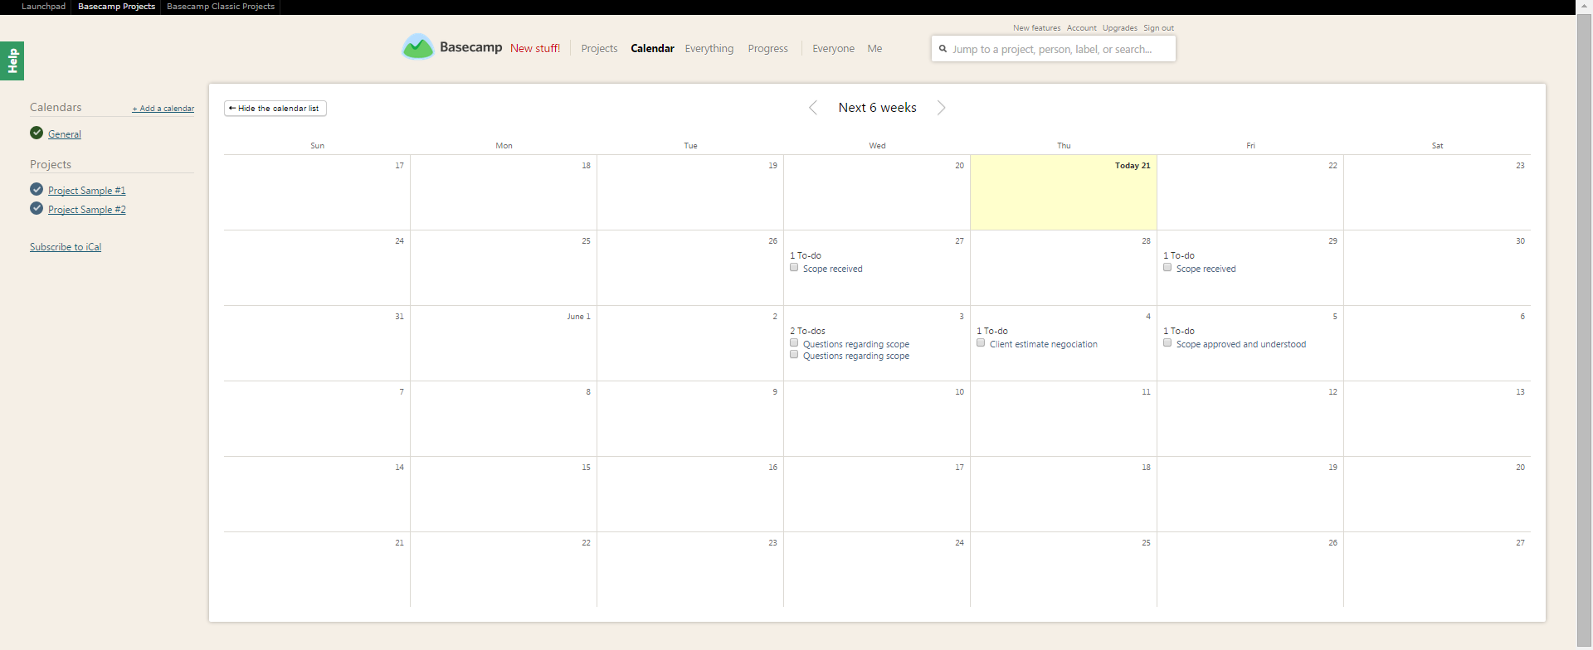
1 - New Project Tiles by Project
Something really cool!
Assign a task to someone and add a due date
Then check out the calendar and see all projects together

Slide 8
2. New Projects share a Tile –
Divided by Project Headings
Pro’s
  All projects are in one place
Con’s
  Project lists can become overwhelming
  To-Do’s are limited to headings only, therefore tasks cannot be tracked by assignee and/or dates

Slide 9
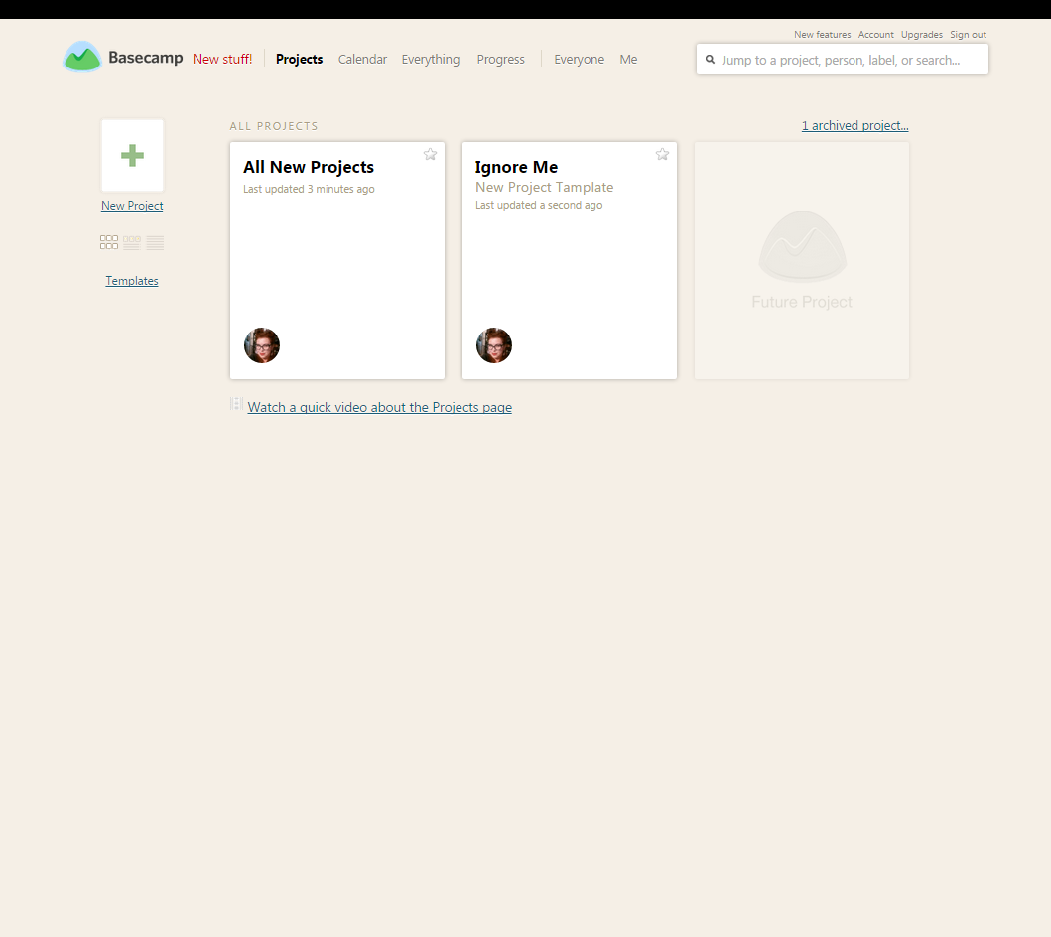

2. New Projects share a Tile –
Divided by Project Headings
Open the New Projects Tile
Create a new To-Do Lists
  Add the Project Name at the top
  Add these to-do’s
    Scope
    Estimate
    Design
    Development
    Test & QA
    Launch

Slide 10
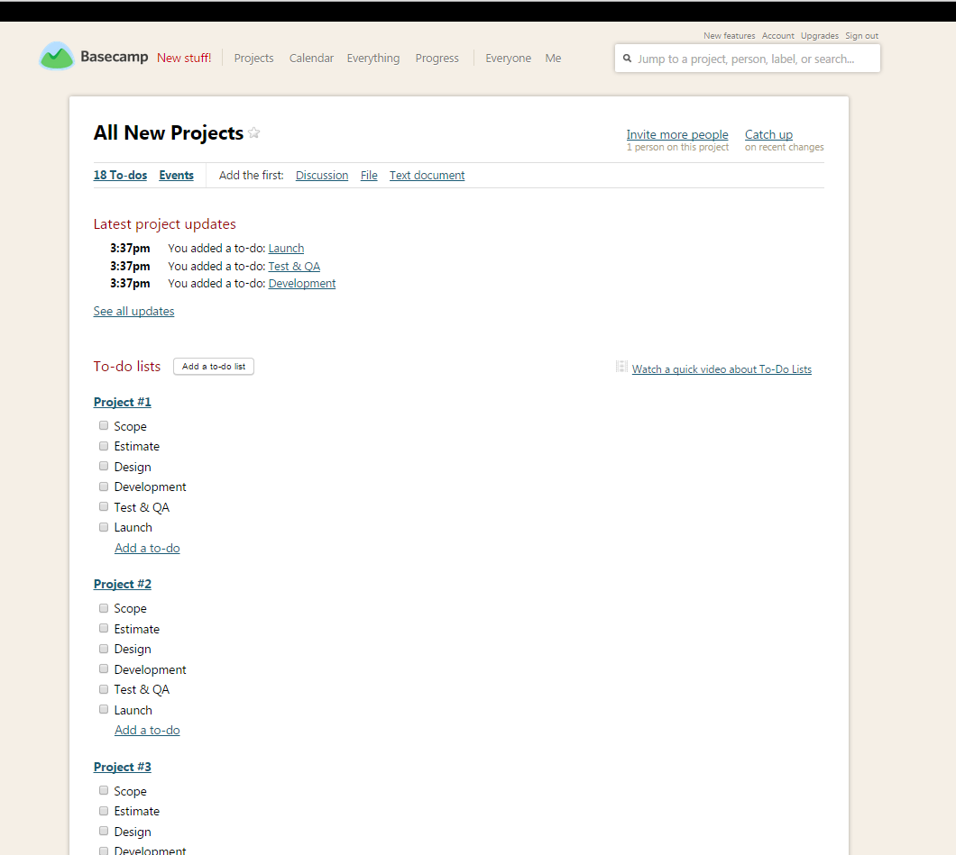
2. Sample

Slide 11
3. New Projects share a Tile –
Divided by Project Stage
Pro’s
  All projects are in one place
  All projects are moved into existing headings
Con’s
  Project lists can become overwhelming
  To-Do’s are limited to headings only, therefore tasks cannot be tracked by assignee and/or dates
  Wrong mouse moves can drastically skew placement of where a project is

Slide 12
3. New Projects share a Tile –
Divided by Project Stage
Open the New Projects Tile
Create a new To-Do Lists
  With the following headers
    Scope
    Estimate
    Design
    Development
    Test & QA
    Launch

Slide 13
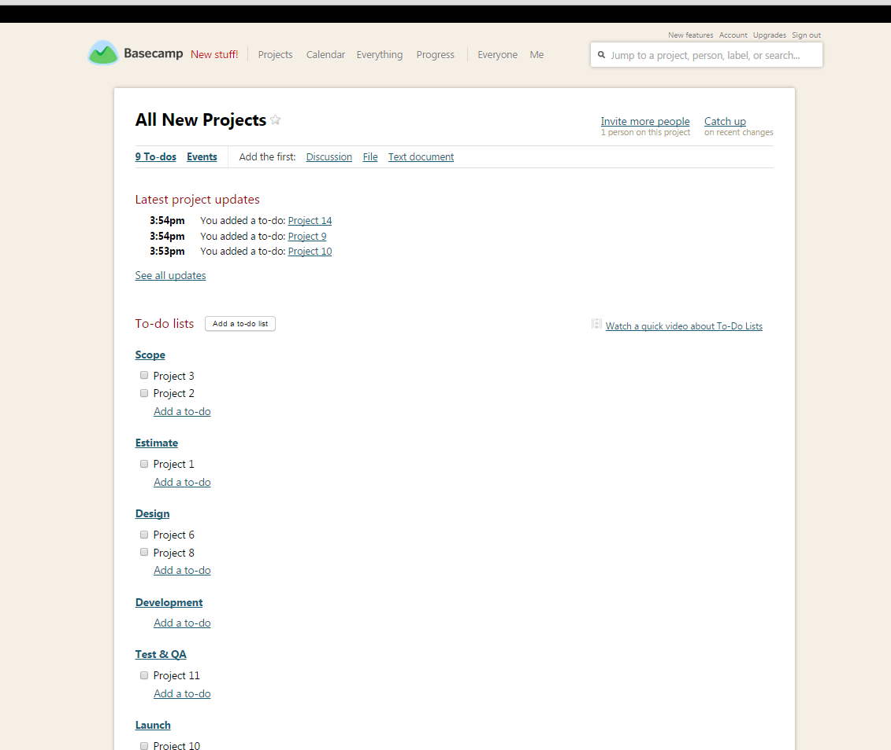
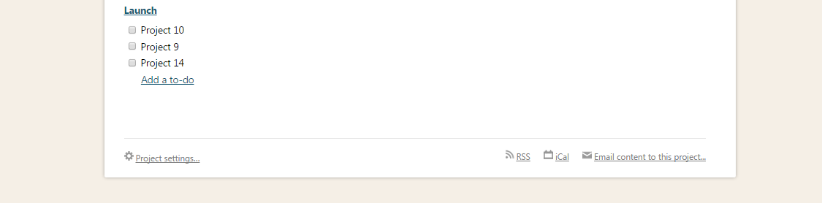
3 - Sample

